Slide 1

GUSTAVO GARRAFOLI 19.03.25

Slide 2
AGENDA
I. Presentation of Tableau History H.1. Overall — 8min
II. SQL DER and Answers (Git Hub) — 4min
III. APIs and Python programming (Git Hub) — 4min
VI. Conclusion — 12min
V. Researched sources — 2min

Slide 3
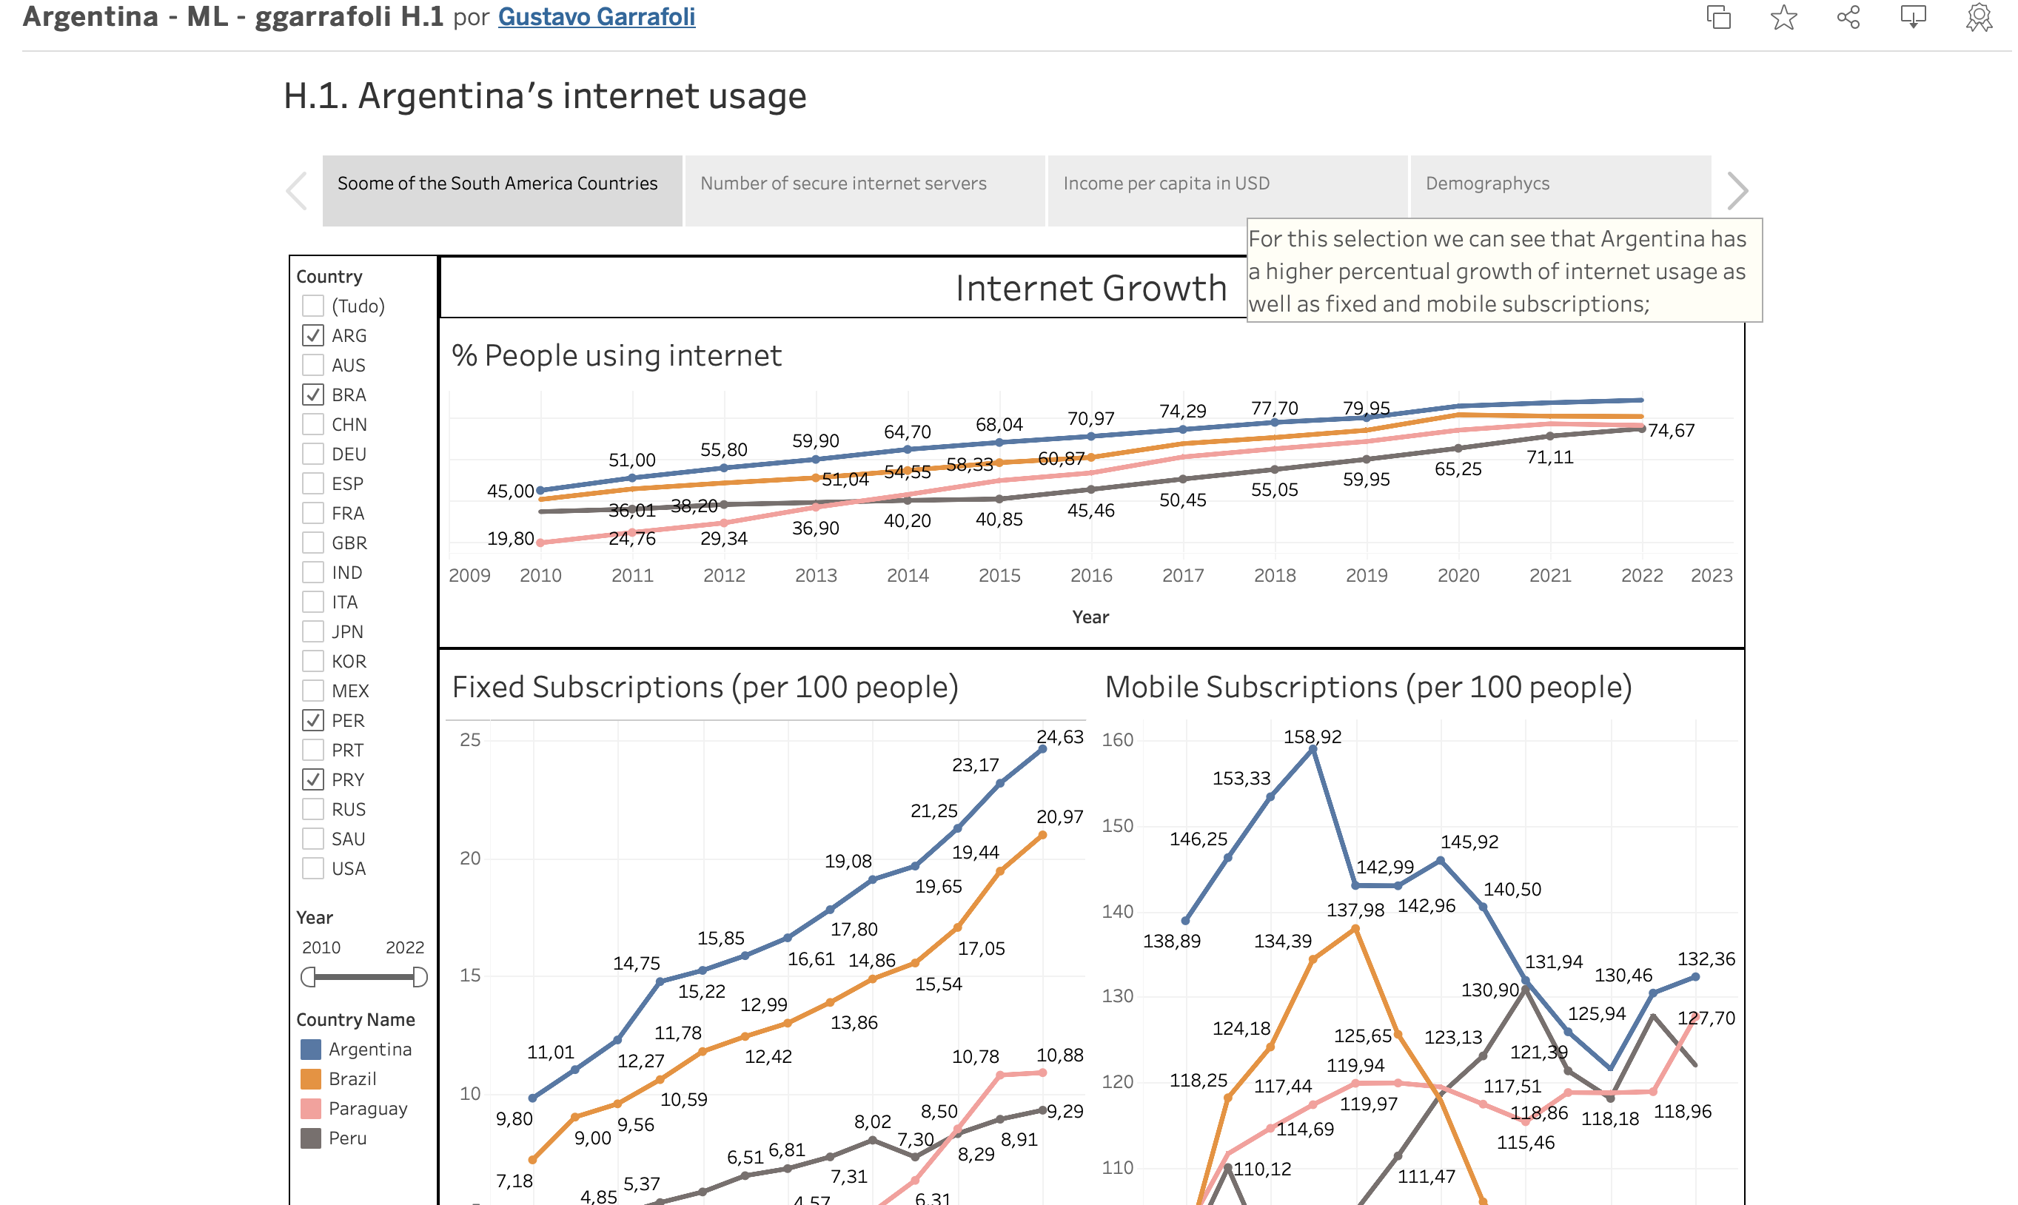
I. TABLEAU HISTORY H.1. OVERALL
https://public.tableau.com/app/profile/gustavo.garrafoli4463/viz/Argentina-ML-ggarrafoliH_1/H_1_Overall?publish=yes

Slide 4
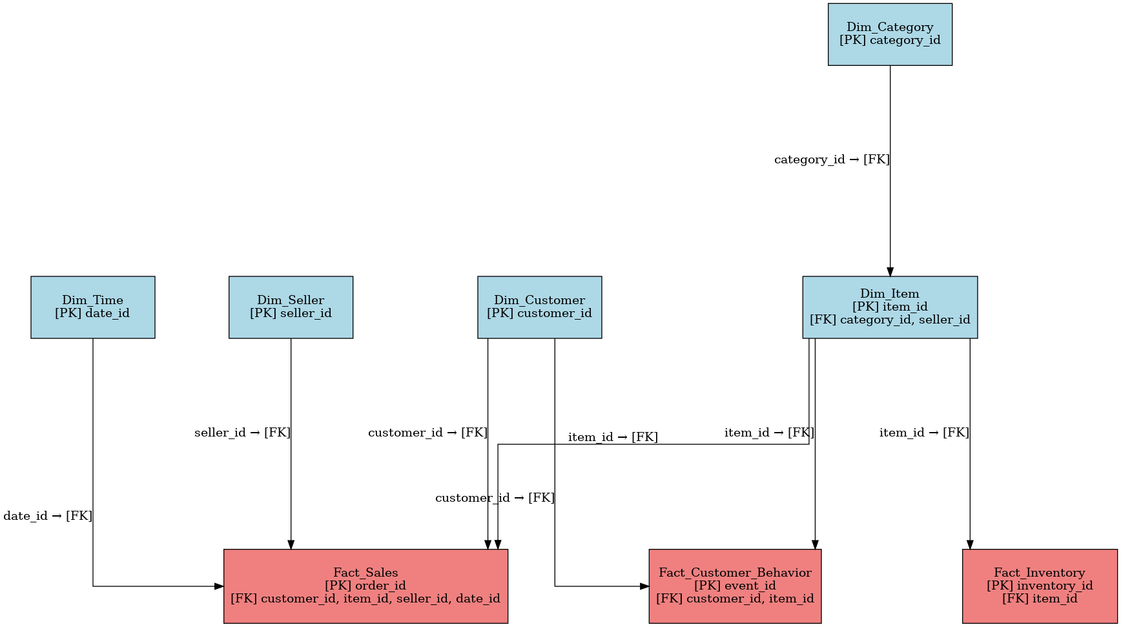
II. SQL DER AND ANSWERS (GIT HUB)
DER:
Git Hub:
https://github.com/ggarrafoli2/mercado_livre

Slide 5
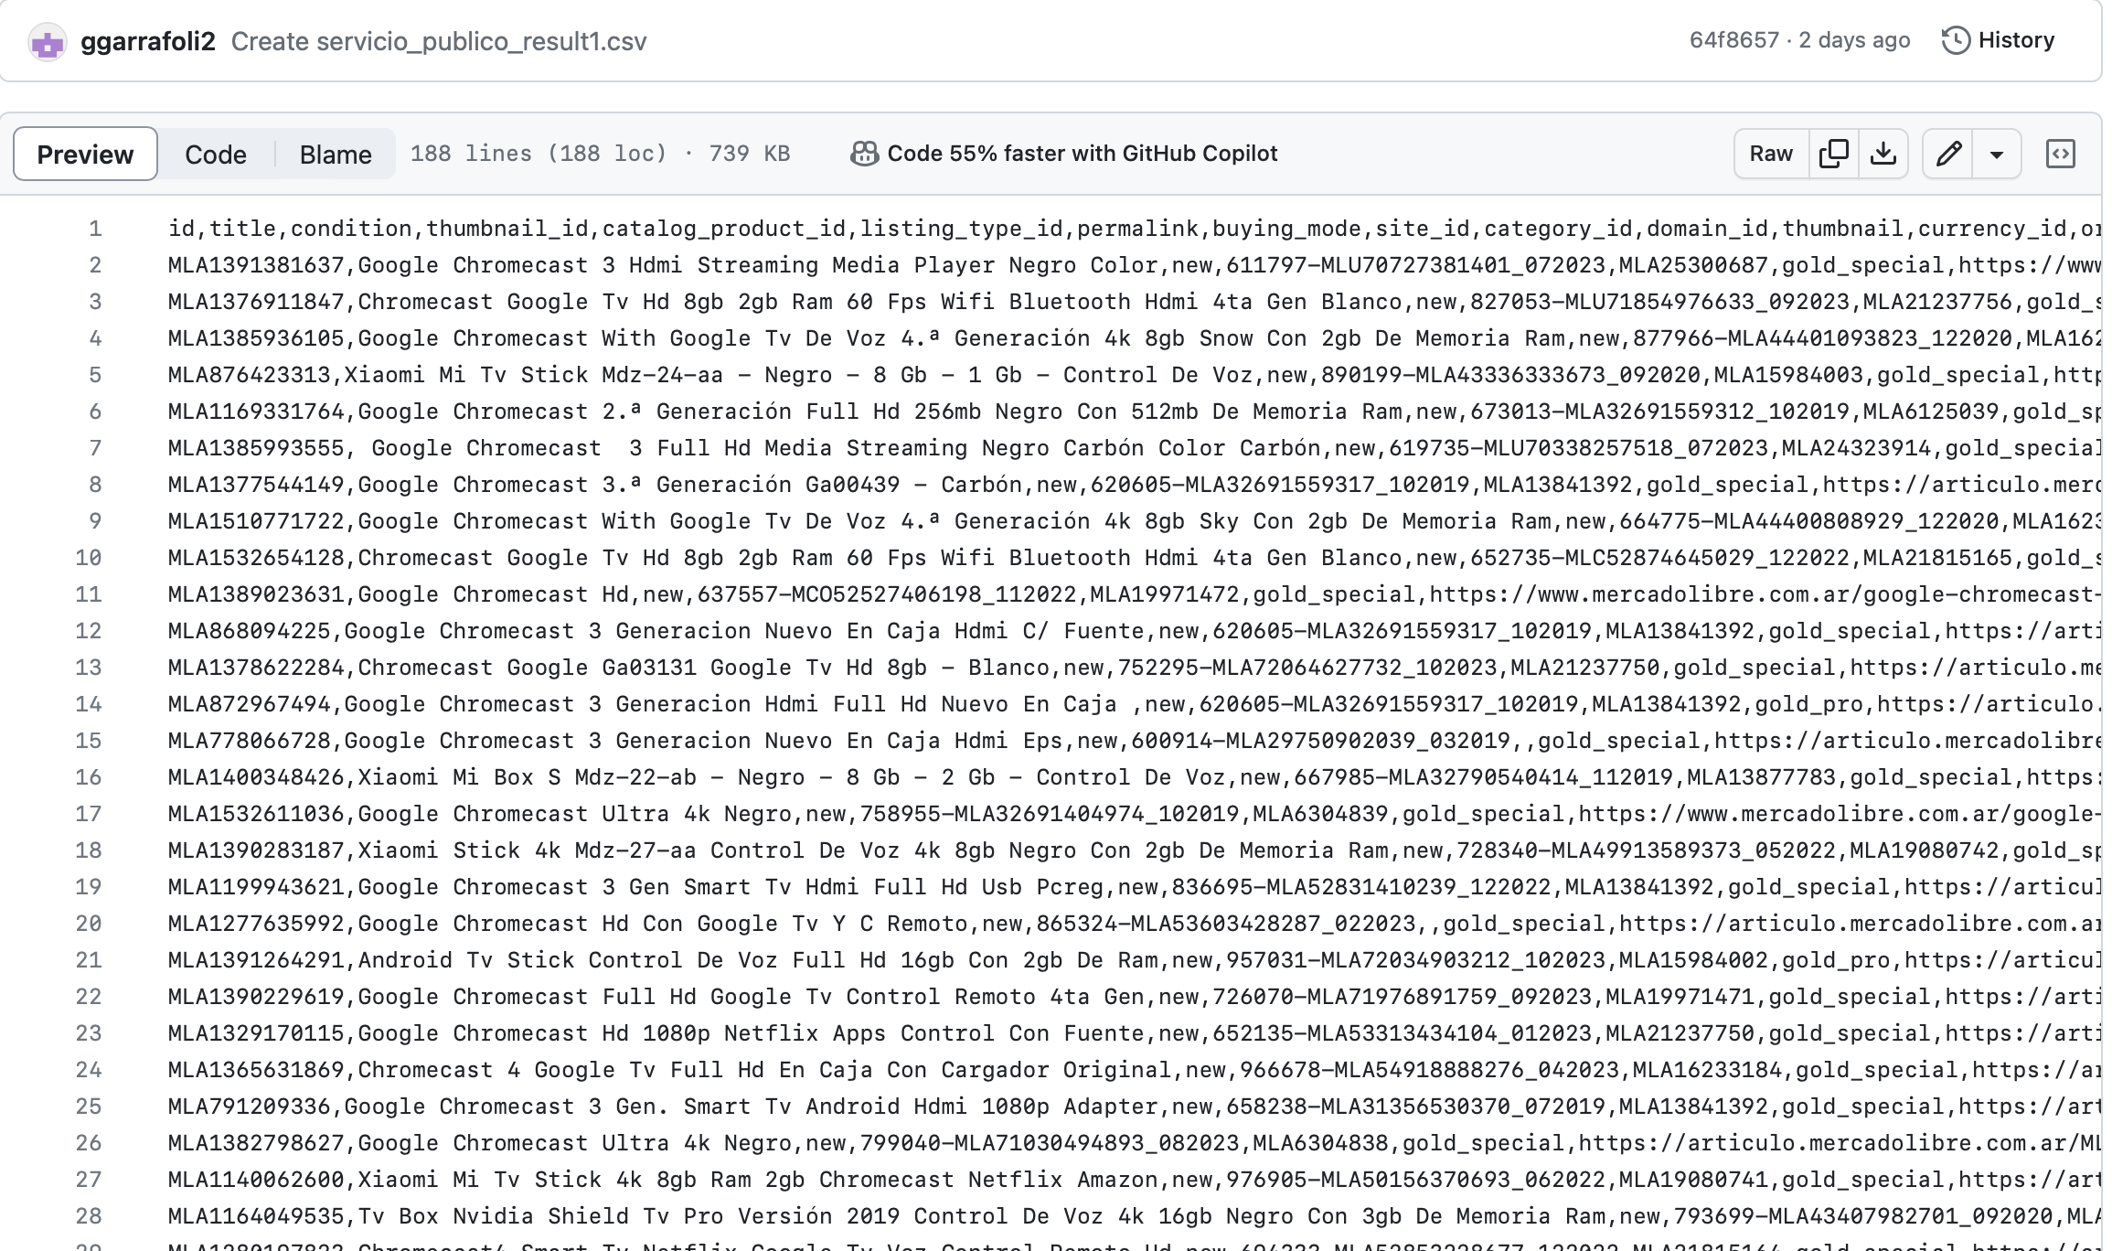
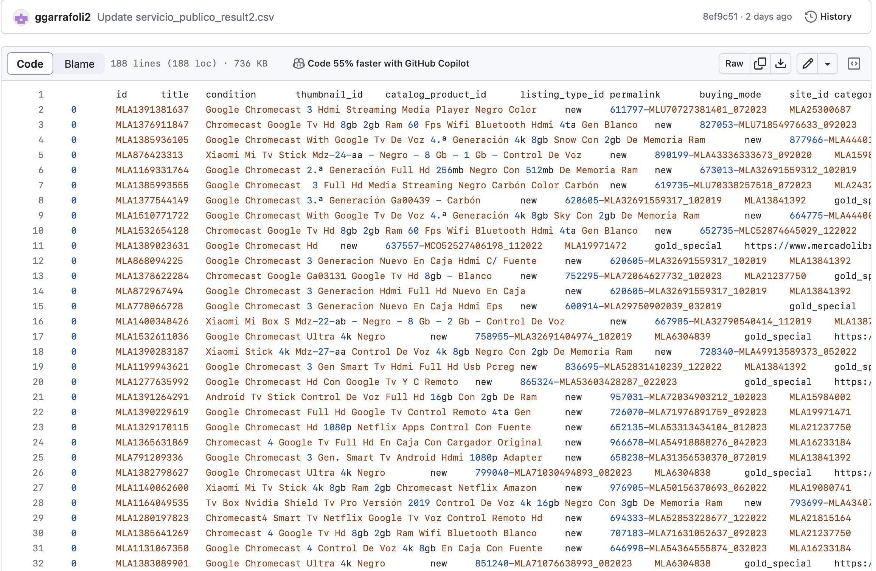
III. APIS AND PYTHON PROGRAMMING
https://github.com/ggarrafoli2/mercado_livre

Slide 6
IV. CONCLUSIONS
1. Argentina's internet usage is very extensive considering all the countries in this research. It stays in the middle of 19 countries from different continents. It gets up to 88.38% in 2022.
II. Infrastructure grew a lot like we could see in secure servers KPI. It will continue growing and could do better if the country had better per capita income.
III. From 2013 on, we can see an increase of Mobile subscriptions KPI. It reaches it's top in this year with 158.92 subscriptions per 100 people.
IV. Covid 19 lockdown in 2020 made another peak in mobile subscripcions in 2021 after several years dropping. (130.46 per 100 habitants). Also, there was an increase of work and studies in remote mode from home that corroborate to those numbers.
V.“Plano Conectar 2020 - 2023” from the government invested almost 20 Billion pesos in satellite ARSAT-SG1 to increase connectivity especially in rural areas and REFERO - “Rede Federal de Fibra Optica" to update optic fiber and connect more 22M people up to 2023. Investment up to 13.2 Billion pesos.
VI. Importance of conectivity. Argentina has a very engaged population in online activities such as streamming, gamming, social media and shopping. There is no way back for any country about the need to be connected for bunisess, convenience or enterteinament. The factors that will decide de ammount of growth is the net income to citizens, political policies and investments in technology.

Slide 7
V. RESEARCHED SOURCES
I. https://databank.worldbank.org/source/world-development-indicators/preview/on#
II. https://g1.globo.com/economia/noticia/2020/08/22/argentina-congela-tarifas-de-celular-internet-e-tv-por-assinatura-e-regula-futuros-aumentos.ghtml
III. https://replit.com/~
VI. https://olhardigital.com.br/2019/09/23/noticias/android-faz-11-anos-relembre-alguns-de-seus-momentos-importantes/
V. https://www.oficinadanet.com.br/smartphones/33181-todos-os-iphones-ja-lancados

